Slide 1

UNIVERSITI TEKNOLOGI MALAYSIA
SECP3623 - DATABASE PROGRAMMING
2025/2026 - SEM 1
Project II (10%) – NoSQL MongoDD
Name | : | Cheryl Cheong Kah Voon
Matric Id | : | A23CS0060
Name | : | Lau Yee Wen
Matric Id | : | A23CS0099
Name | : | Lee Yin Shen
Matric Id | : | A23CS0236
Name | : | Poh Lok Yee
Matric Id | : | A23CS0262

Slide 2


Event Booking System
Database Programming (SECP3623) - Project ​II

Slide 3
Introduction
Event Booking System
Allows participants to register and book events organized by different companies or brands
manages event and organizer information, participant details, and booking records, including payment information
Why We Choose It?
Objectives
Involves flexible data structures
different event details
multiple bookings for each participant
payment information
Design MongoDB backend
Perform CRUD
Perform advanced operation 1)aggregation queries 2)indexing

Slide 4
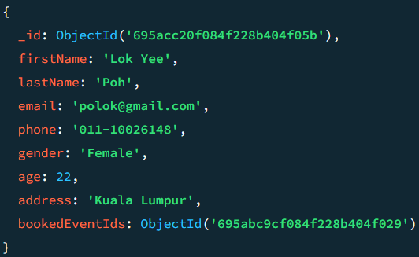
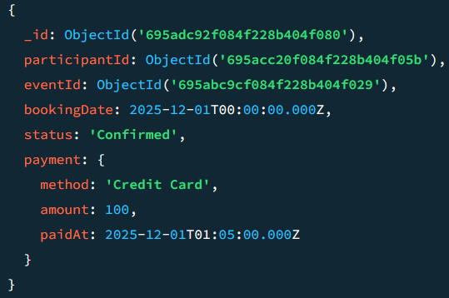
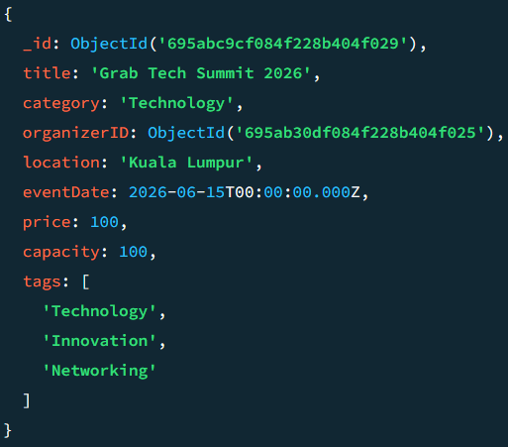

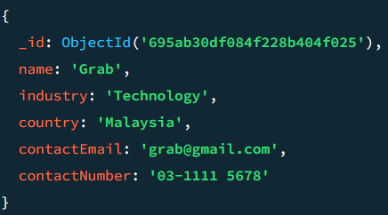
Database: Event_Booking_System – 4 Collections
NoSQL Modelling
01
02
03
04
Organizers
Events
Participants
Bookings
Stores information about event organizers
Contains details of event
Represents users who register for events, including their personal information and the events they have booked
Tracks participant bookings for events and includes payment details along with booking status.
Data Type Used:
String
Data Type Used:
String, Number, Date, Array
Data Type Used:
String, Number
Data Type Used:
String, Number, Date, Object

Slide 5
Embedding vs Referencing
Stores related data directly inside a document
Links documents across collections using unique identifiers
Applied in Bookings collection using participantId and eventId to link each booking to a participant and an event
Used for the payment information within each booking, keeping details in a single document for easier access.

Slide 6
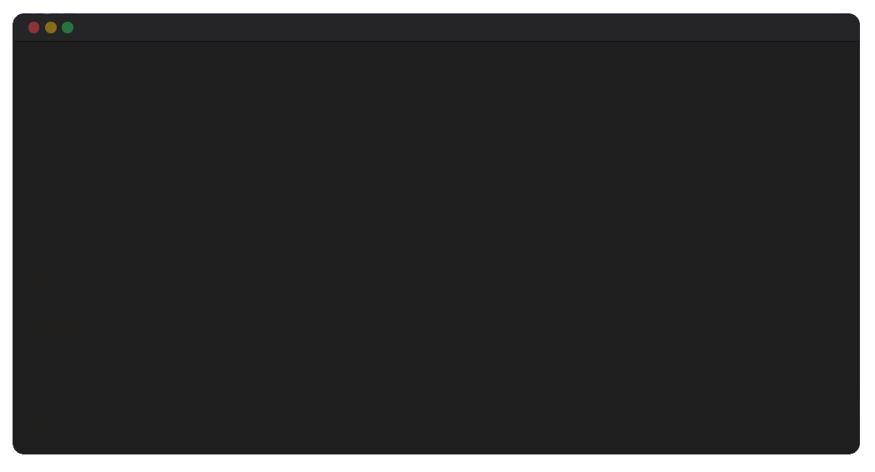
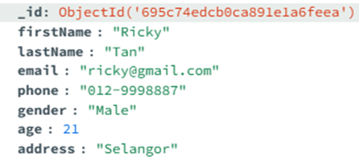

CRUD Operations
Insert Operations (CREATE)
db.participants.insertOne({
"firstName": "Ricky",
"lastName": "Tan",
"email": "ricky@gmail.com",
"phone": "012-9998887",
"gender": "Male",
"age": 21,
"address": "Selangor"
})
Use the insertOne() command to add a new participant (Ricky) into the participants collection.

Slide 7
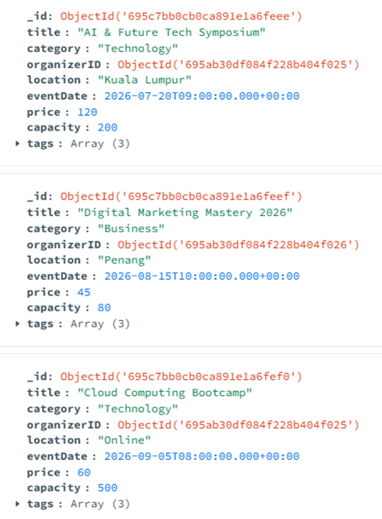
CRUD Operations
Insert Operations (CREATE)
db.events.insertMany([
{
"title": "AI & Future Tech Symposium",
"category": "Technology",
"organizerID": ObjectId("695ab30df084f228b404f025"),
"location": "Kuala Lumpur",
"eventDate": ISODate("2026-07-20T09:00:00Z"),
"price": 120,
"capacity": 200,
"tags": ["AI", "Future Tech", "Symposium"]
},
{
"title": "Digital Marketing Mastery 2026",
"category": "Business",
"organizerID": ObjectId("695ab30df084f228b404f026"),
"location": "Penang",
"eventDate": ISODate("2026-08-15T10:00:00Z"),
"price": 45,
"capacity": 80,
"tags": ["Marketing", "Digital", "Workshop"]
},
{
"title": "Cloud Computing Bootcamp",
"category": "Technology",
"organizerID": ObjectId("695ab30df084f228b404f025"),
"location": "Online",
"eventDate": ISODate("2026-09-05T08:00:00Z"),
"price": 60,
"capacity": 500,
"tags": ["Cloud", "Coding", "Education"]
}
])
Use the insertMany() command to add multiple events into the events collection.

Slide 8
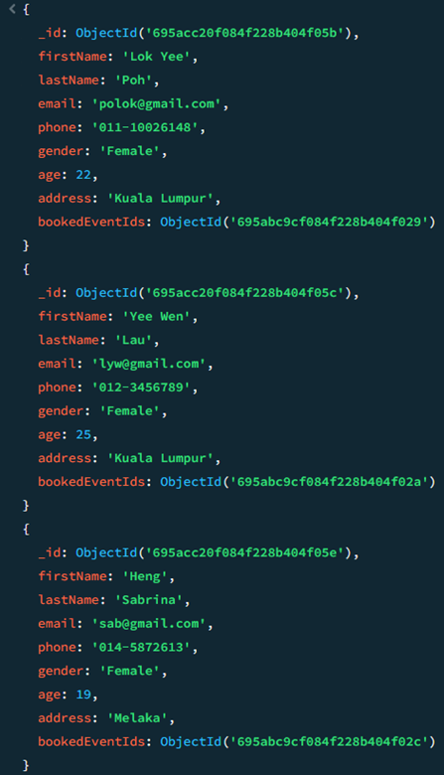
CRUD Operations
Query Operation (READ)
Use the find() command to retrieve the info of all participants who is female.
db.participants.find({ "gender": "Female" })

Slide 9
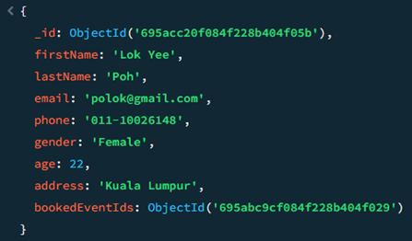
CRUD Operations
Query Operation (READ)
Use the findOne() command to find the first participant who gender is female.
db.participants.findOne({ "gender": "Female" })

Slide 10
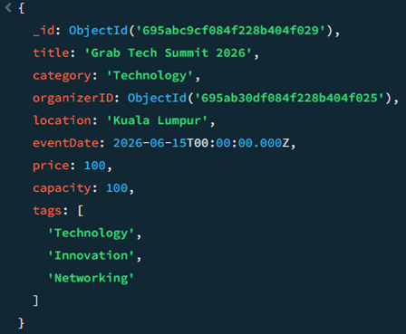
CRUD Operations
Query Operation (READ)
Use the find() and $gt command to retrieve the events info where the price is greater than 60.
db.events.find({
"price": { $gt: 60 }
})

Slide 11
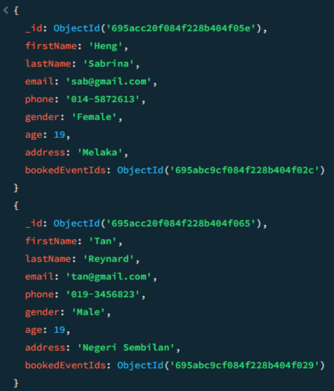
CRUD Operations
Query Operation (READ)
Use the find() and $lt command to retrieve the participants info where their age is less than 20.
db.participants.find({
"age": { $lt: 20 }
})

Slide 12
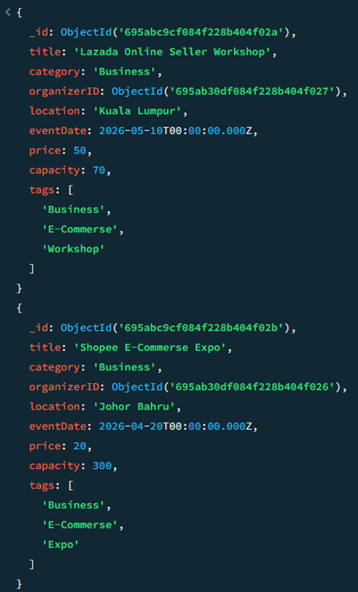
CRUD Operations
Query Operation (READ)
Use the find() and $eq command to retrieve the events info where the category is equal to Business.
db.bookings.find({
"category": { $eq: "Business" }
})

Slide 13
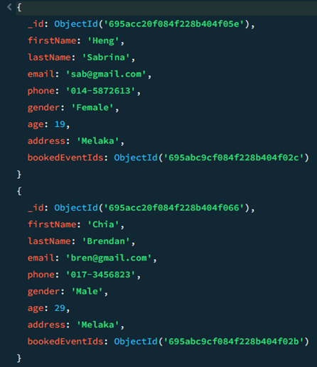
CRUD Operations
Query Operation (READ)
Use the find() and $in command to find the participants info where their address value is match the “Melaka”.
db.partipants.find({
"address": { $in: ["Melaka"] }
})

Slide 14
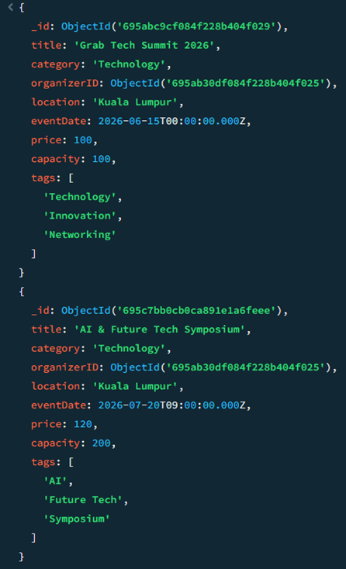
CRUD Operations
Query Operation (READ)
Use the find() and $and command to retrieve the events info that satisfied two condition at the same time, where location is “Kuala Lumpur”, and capacity is greater than 80.
db.events.find({
$and: [
{ "location": "Kuala Lumpur" },
{ "capacity": { $gt: 80 } }
]
})

Slide 15
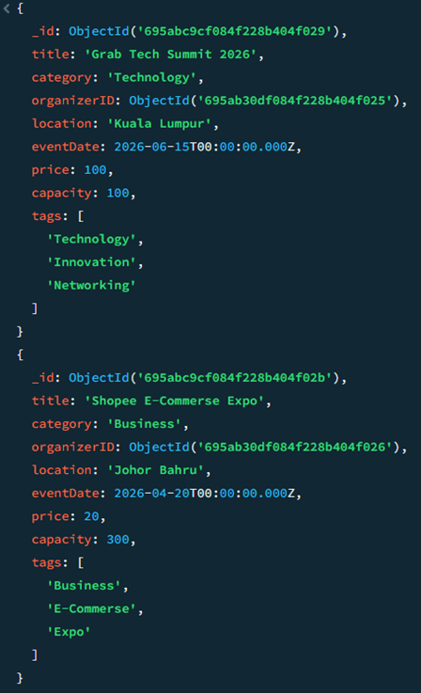
CRUD Operations
Query Operation (READ)
Use the find() and $or command to retrieve the events info that satisfied either one of the condition, where either category is “Technology” or price is less than 30.
db.events.find({
$or: [
{ "category": "Technology" },
{ "price": { $lt: 30 } }
]
})

Slide 16
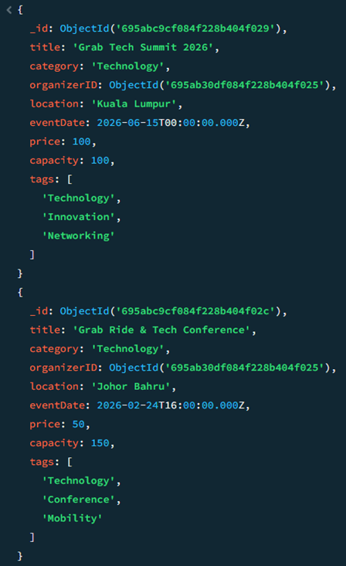
CRUD Operations
Query Operation (READ)
Use the find() command to query an array field to retrieve all events where the "tags" array contains the value “Technology”.
db.events.find({
"tags": "Technology"
})

Slide 17
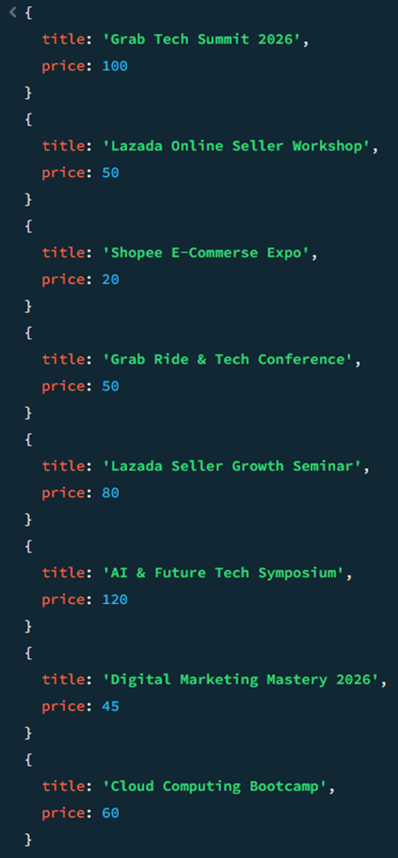
CRUD Operations
Query Operation (READ)
Use the find() command with projection to retrieve all events info. Use 1 to show the title and price fields and 0 to hide the _id field.
db.events.find(
{},
{ "title": 1, "price": 1, "_id": 0 }
)

Slide 18
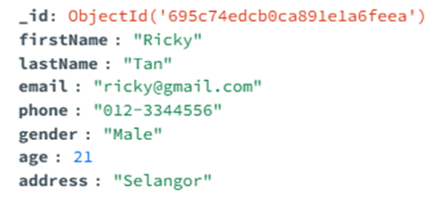
CRUD Operations
Update Operations (UPDATE)
Use the updateOne() and $set command to update the participants info who’s name is Ricky, then update his phone number.
db.participants.updateOne(
{ "firstName": "Ricky" },
{ $set: { "phone": "012-3344556" } }
)

Slide 19
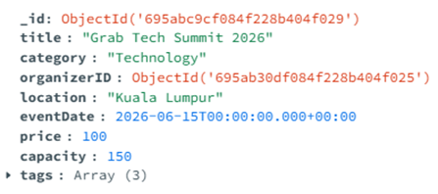
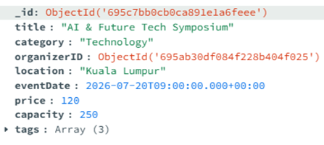
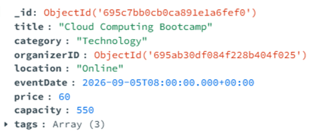
CRUD Operations
Update Operations (UPDATE)
Use the updateMany() and $inc command to increase capacity of multiple events where the category is “Technology” by 50 simultaneously.
db.events.updateMany(
{ "category": "Technology" },
{ $inc: { "capacity": 50 } }
)

Slide 20
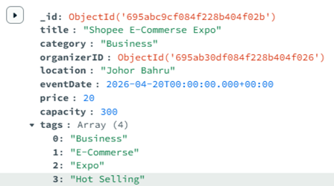
CRUD Operations
Update Operations (UPDATE)
Use the updateOne() and $push command to add a new value “Hot Selling” into the tags array of the “Shopee E-Commerse Expo” event.
db.events.updateOne(
{ "title": "Shopee E-Commerse Expo" },
{ $push: { "tags": "Hot Selling" } }
)

Slide 21
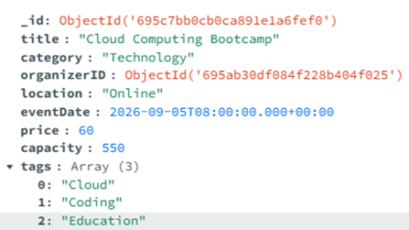
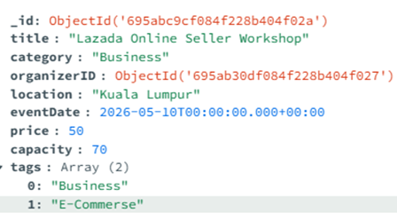
CRUD Operations
Update Operations (UPDATE)
Use the updateMany() and $pull command to remove the specific value “Workshop” from the tags array of all events.
db.events.updateMany(
{ "tags": "Workshop" },
{ $pull: { "tags": "Workshop" } }
)

Slide 22
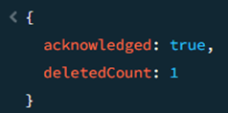
CRUD Operations
Delete Operation (DELETE)
Use the deleteOne() command to remove a specific document in “bookings” with specific objectID.
db.bookings.deleteOne({
"_id": ObjectId("695adc92f084f228b404f080")
})

Slide 23
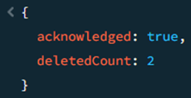
CRUD Operations
Delete Operation (DELETE)
Use the deleteMany() command to remove multiple document that match the condition where address is “Melaka”.
db.participants.deleteMany({
"address": "Melaka"
})

Slide 24




Advanced: Indexing Strategy
Single Index
Compound Index
We use createIndex() to create an index on the eventId field in the bookings collection to speed up queries that retrieve bookings based on event ID.
We use createIndex() to create a compound index on the eventId and bookingDate fields to optimize queries that retrieve bookings for a specific event and sort them by booking date.
Output:
Output:
We use createIndex() to create an index on the category field in the events collection to improve query performance when filtering events by category.
Output:

Slide 25
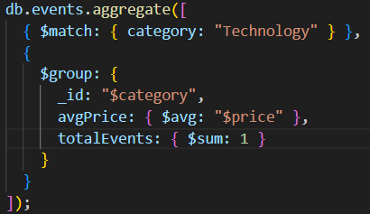
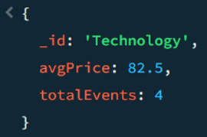
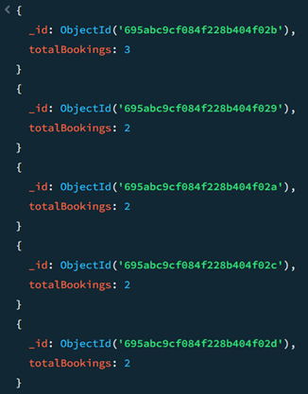
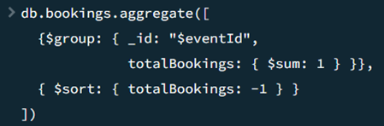
Advanced: Aggregation Pipelines
Use the $match stage to filter events that belong to the Technology category, followed by the $group stage to calculate the average event price and total number of events in that category.
Output:
Use the $group stage to calculate the total number of bookings for each event, followed by the $sort stage to rank events based on the number of bookings in descending order.
Output:

Slide 26


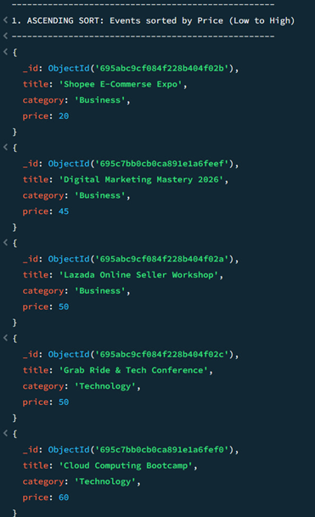
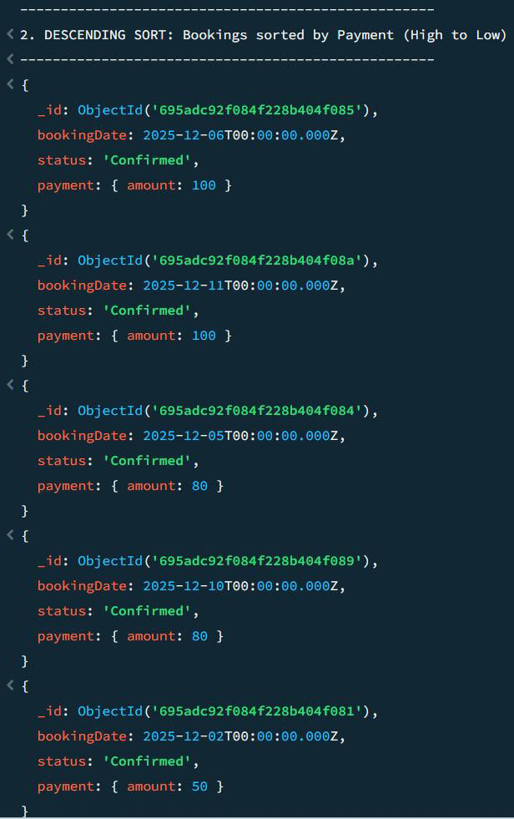
Sorting Demonstration
Ascending Order
Descending Order
We sort the events collection by the price field in ascending order.
We sort the bookings collection by payment.amount in descending order.

Slide 27
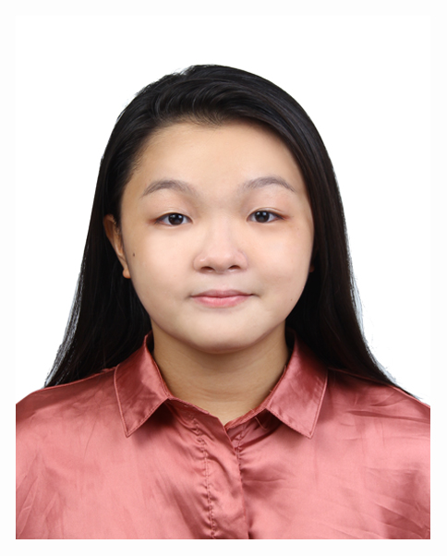
Contribution
As a database designer
Responsible to design the overall NoSQL database for the event booking system.
Created collections for organizers, events, participants, and bookings, with sample documents using arrays, embedded documents, and references.
Ensured data is logically connected and realistic for CRUD and advanced MongoDB operations.
POH LOK YEE

Slide 28
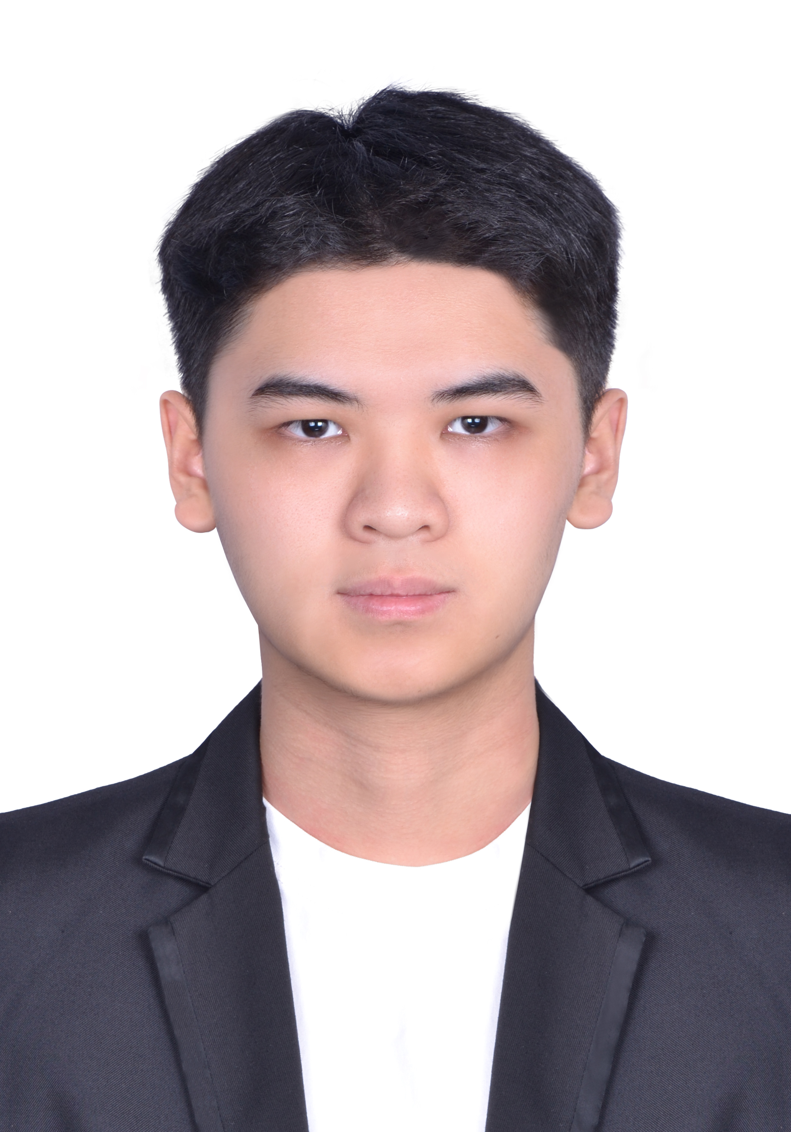
Contribution
As a CRUD Specialist
Responsible to handle CRUD operations (Create, Read, Update, Delete) for the Event Booking System.
Implemented data insertion to populate the system and developed search queries to retrieve specific event details.
Managed data updates for database modication, and executing delete commands to remove specific data and ensure database accuracy.
LEE YIN SHEN

Slide 29

Contribution
As a Data Analyst
Responsible for optimizing data access and supporting analytical queries within the Event Booking System.
Implemented indexing on key fields to enhance query efficiency and ensure performance-oriented data analysis.
Developed aggregation pipelines to generate meaningful summaries and analyze patterns such as event pricing and booking distribution.
CHERYL CHEONG KAH VOON

Slide 30

Contribution
As a Database Administrator
Implemented the sorting functions to organize events and bookings, such as listing items by price or payment amount
Analyzed and documented how indexing strategies optimized query speeds compared to standard collection scans.
Documented the technical challenges we faced, like script errors and software limitations
Identified NoSQL injection risks, defined access controls, and outlined data consistency constraints.
LAU YEE WEN

Slide 31


THANK YOU
utmofficial
univteknologimalaysia
utm.my

